Slide 1
Determining Heart Disease Using Machine Learning So You Don’t Have To!
By Sean Rommes

Slide 2
Overview
1 You! The Stakeholder
2 Identifying the Problem
3 Objectives
4 A brief description of the data used
5 Visualizations
6 Machine Learning Model
7 Final notes

Slide 3
Hospitals and Emergency Rooms/Clinics
This presentation was designed with health care directors in mind to help optimise diagnostic processes for doctors regarding heart disease. Doctors can get bogged down with patients, resulting in inconsistent or poor quality of care, mistakes being made, and conditions being overlooked. Time is a valuable resource, allow me to offer you a tool to improve the quality of your care for everyone!

Slide 4
The Problem
1: Heart disease is a silent killer.
While most countries recommend getting tested at a certain age, heart failure doesn’t always present itself with obvious symptoms until it’s too late. Ideally we’d like to catch it early so people can have a long, satisfying life.
2: How can we detect it? What tests are reliable?
There are a number of different tests used to investigate heart disease, like ECG’s, Oldpeak scores, exercise tests, resting blood pressure, cholesterol, and max heart rate. Unfortunately these tests are somewhat limited and may not always be reliable indicators of heart disease.

Slide 5
Objective
The goal of this project is to present you with a machine learning model that can quickly examine the test results of patients who are at risk of heart disease and accurately predict whether a patient will develop it or not. This is not meant to replace doctors but to simply be another tool for doctors to use so they can spend more time caring for patients and less time pouring over test results. Based off what the model presents doctors can decide what the next course of action should be for their patients.

Slide 6
The Data
The data used to create our model was based off this data set:
https://www.kaggle.com/datasets/fedesoriano/heart-failure-prediction
It is a combination of 5 datasets consisting of 918 observations. The dataset consists of a persons age, sex, chest pain type, resting blood pressure, cholesterol levels, if their fasting bloodsugar was above or below 120 mg, the patients resting ECG, max heartrate, if they had angina during exercise, old peak score, ST slope, and if patient developed heart disease.

Slide 7
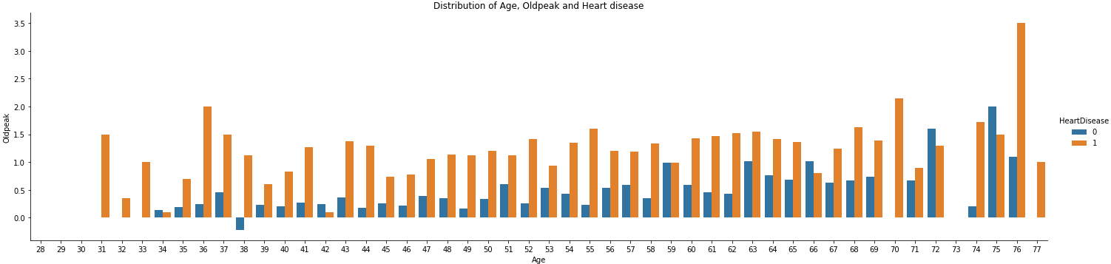
Distribution of Age Oldpeak and Heart Disease
Oldpeak had the highest correlation to heart disease. The higher your oldpeak the more likely you are to develop heart disease, but the average range is between 1 and 2 with some outliers resting above and below. While not demonstrated here, people between the ages of 45 and 70 had the highest distribution of heart disease, ranging around 60 - 83% likelihood based off those tested(from youngest to oldest).

Slide 8
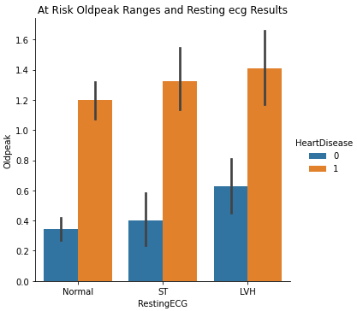
At Risk Oldpeak Ranges and ECG Results
This plot compares ECG results to old peak ranges and heart disease. The black lines resting on the top of each column is the margin of error for each bar. Ultimately what this graph tells us is that you can still get normal results on your ECG and develop heart disease if its above a certain range. In fact there isn’t much of a difference between each range and abnormal ECG results. While not demonstrated here 56% of people in the data set had heart disease. Many of whom were asymptomatic, and those that experienced angina during exercise had a significantly higher chance of developing heart disease.

Slide 9
Recommended Machine Learning Model
I generated 4 machine learning models. My random forest model performed the best. It was able to identify 96% of the true positives with only a 10% variance in fitting, meaning it might struggle a bit with new data. However, if you choose to use this model only about 1 in 20 patients with heart disease could miss out on treatment due to a false negative as opposed to 16 to 68% (1 in 5 to more than half) of misdiagnosis based off this article.
https://psnet.ahrq.gov/issue/misdiagnosis-heart-failure-systematic-review-literature
I would like to note that the model can only predict on what it knows, no other health conditions were considered in the data set which can lead to a misdiagnosis

Slide 10
Final notes
This model can save doctors a fair amount of time by acting as a screening process after tests have been conducted. It can provide doctors with a more confident approach to treatment, reduce operating costs, and hopefully save lives by catching heart disease early. While not the largest data set, the model performed quite well on the available data but may struggle somewhat with new information. The model has not been trained on conditions that can mimic heart disease.

